Slide 1

A MAJOR PROJECT ON ONLINE HASHING WITH BIT SELECTION FOR IMAGE RETRIEVAL BACHELOR OF ENGINEERING IN COMPUTER SCIENCE AND ENGINEERING(2018-22)
ANURAG COLLEGE OF ENGINEERING
Aushapur (V), Ghatkesar (M), Medchal (Dist.), Telangana-501 301.
UNDER THE GUIDANCE OF BATCHNO:15
Mrs.m.Prasanna K.LAXMIPRIYA 18PQ1A0550
L.NIThISH KUMAR 18PQ1A0554
j.arun reddy 18PQ1A0536

Slide 2
ABSTRACT
Online hashing methods have been intensively investigated in semantic image retrieval due to their efficiency in learning the hash functions with one pass through the streaming data.
Among the online hashing methods, those based on the target codes are usually superior to others.
However, the target codes in these methods are generated heuristically in advance and cannot be learned online to capture the characteristics of the data.
we propose a new online hashing method in which the target codes are constructed according to the data characteristics and are used to learn the hash functions online.

Slide 3
By designing a metric to select the effective bits online for constructing the target codes, the learned hash functions are resistant to the bit-flipping error.
At the same time, the correlation between the hash functions is also considered in the designed metric.
Hence, the hash functions have low redundancy.
Extensive experiments show that our method can achieve comparable or better performance than other online hashing methods on both the static database and the dynamic database.

Slide 4
EXISTING SYSTEM
There is another hash function selection method , it is different from our method is a batch-based method that designs the measure to select the hash functions from various batch-based hashing methods.
When new data arrives, has to re-learn the hash functions by accumulating all the data, which is time consuming.
Instead, our method is an online hashing method, which both learns the hash functions and selects the hash functions efficiently according to new data

Slide 5
PROPOSED SYSTEM
hashing methods aim to learn the hash functions to map a given data vector to an bit binary code.
Different from other online hashing methods that learn the hash functions collectively by generating a projection matrix, our method treats each hash function as an independent case and learns each hash function according to one bit .
To minimize the global loss, we apply the PA algorithm iteratively over the data tuples
PA algorithm has been proven as a very successful and popular online learning technique for solving many real world applications .

Slide 6
SYSTEM REQUIREMENTS
HARDWARE REQUIREMENTS
System : Pentium IV 2.4 GHz.
Hard Disk : 40 GB.
Ram : minimum of 512 MB.

Slide 7
SYSTEM REQUIREMENTS SOFTWARE REQUIREMENTS SOFTWARE REQUIREMENTS
Operating system : Windows.
Coding Language :JAVA/J2EE
Data Base :MYSQL
IDE :NetBeans8.1

Slide 8
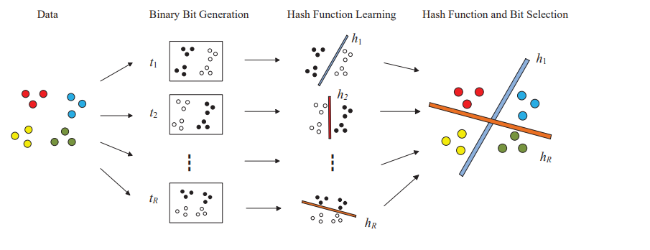
SYSTEM ARCHITECTURE

Slide 9
ER DIAGRAM

Slide 10
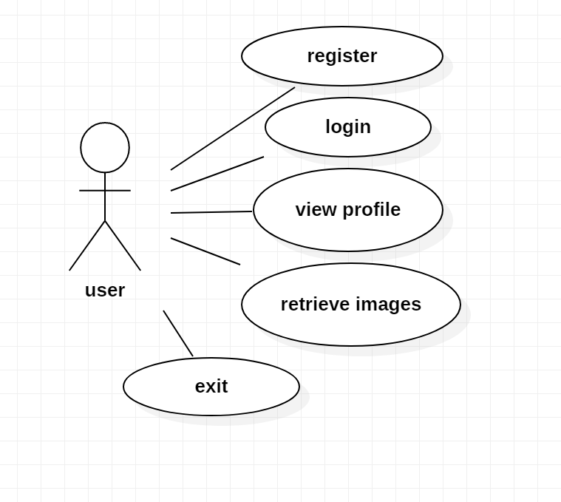
USECASE DIAGRAM USER

Slide 11
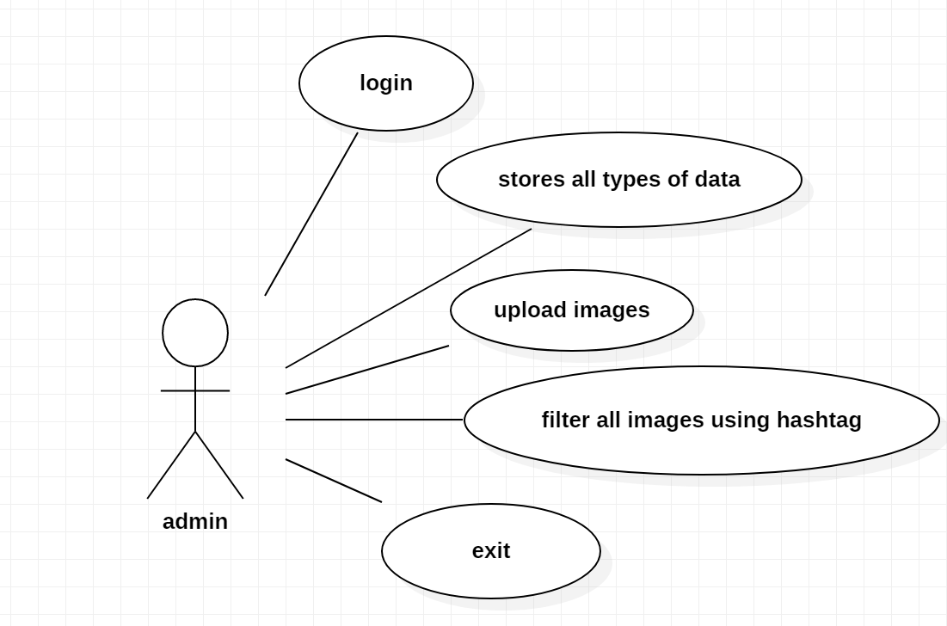
USECASE DIAGRAM ADMIN

Slide 12
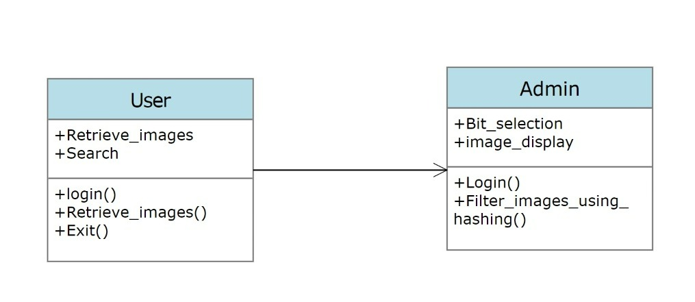
CLASS DIAGRAM

Slide 13
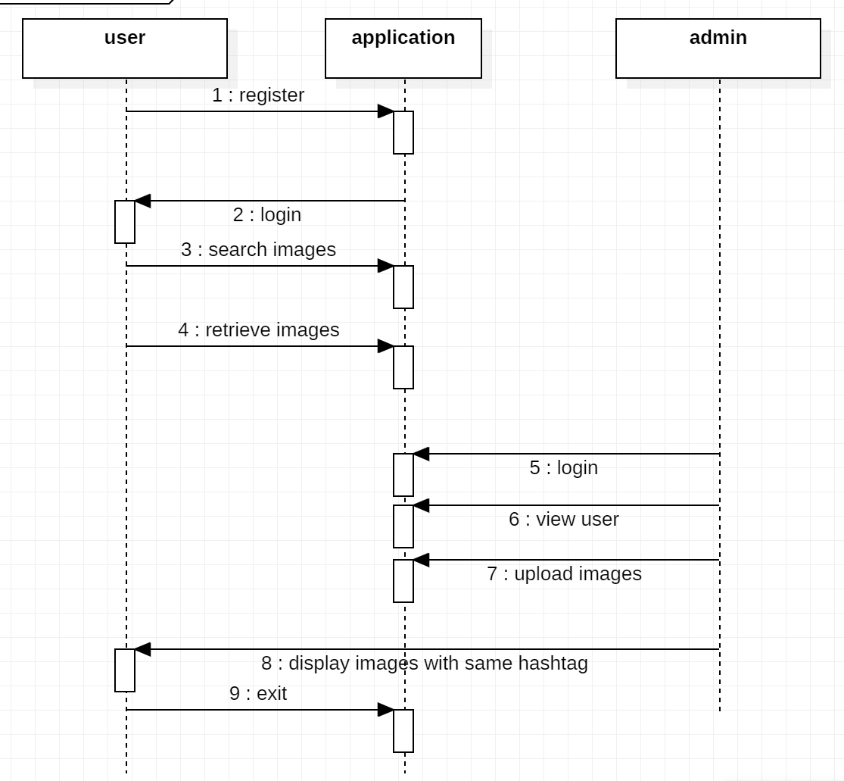
SEQUENCE DIAGRAM

Slide 14
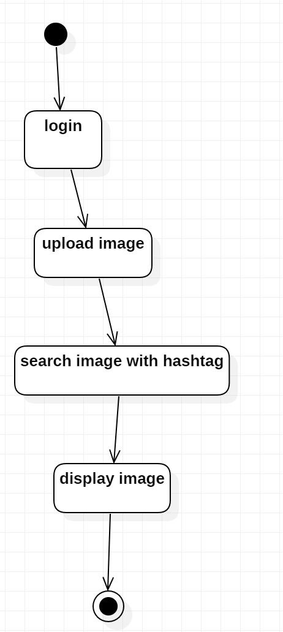
ACTIVITY DIAGRAM ADMIN

Slide 15

ACTIVITY DIAGRAM USER

Slide 16
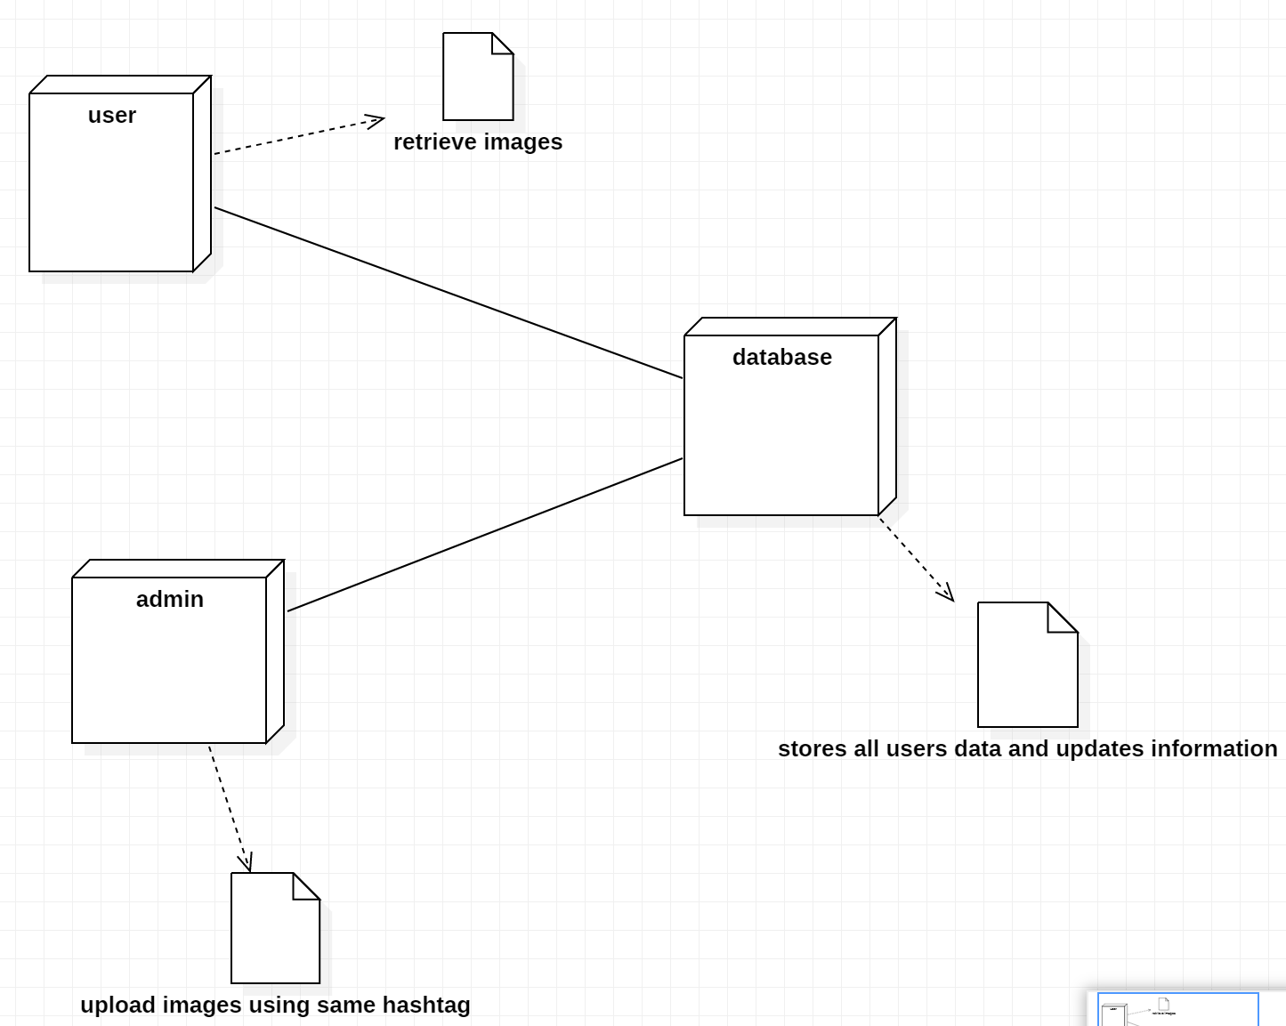
DEPLOYMENT DIAGRAM

Slide 17
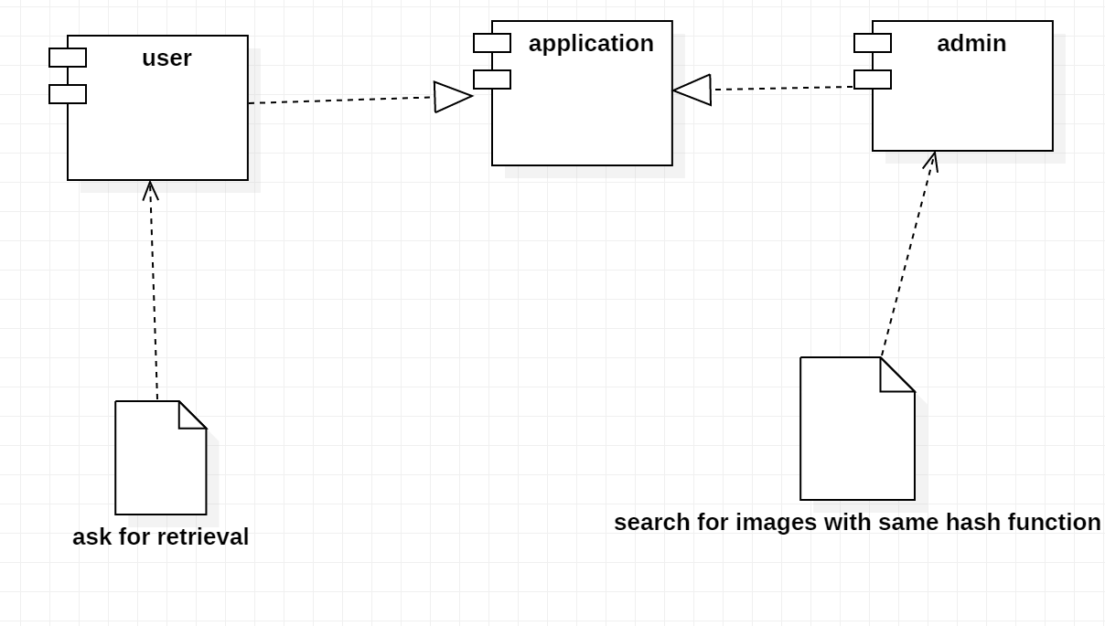
COMPONENT DIAGRAM

Slide 18
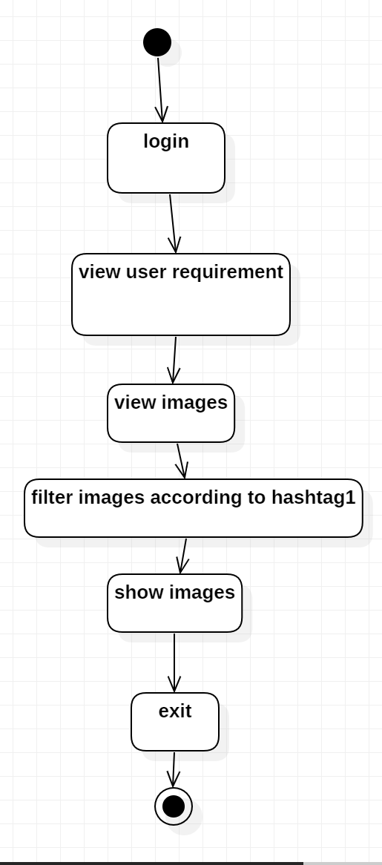
STATE CHART DIAGRAM ADMIN

Slide 19
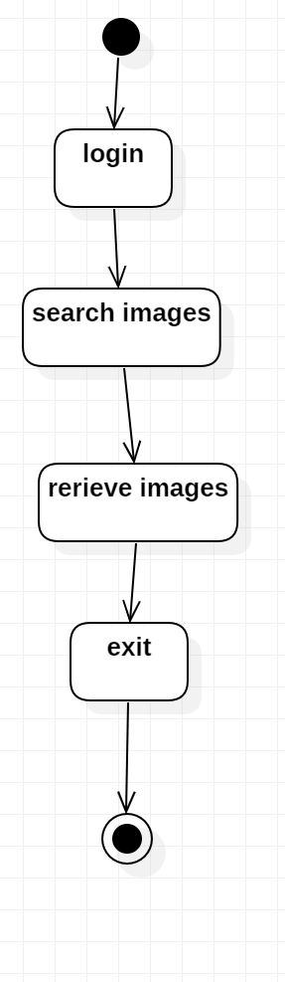
STATE CHART DIAGRAM USER

Slide 20


